Slide 1
SCHOOL OPERATING SYSTEM
SOS is the leading solution for educational institution management, composed of multiple domains like:
Accounting
manager
Teacher
Parent
Student
Sys Admin

Slide 2
SOS
Accountant Domain
Plan Tuitions & Fees
Accept & Make Payments
Student & Family Financial Details
Basic Financial Reporting

Slide 3
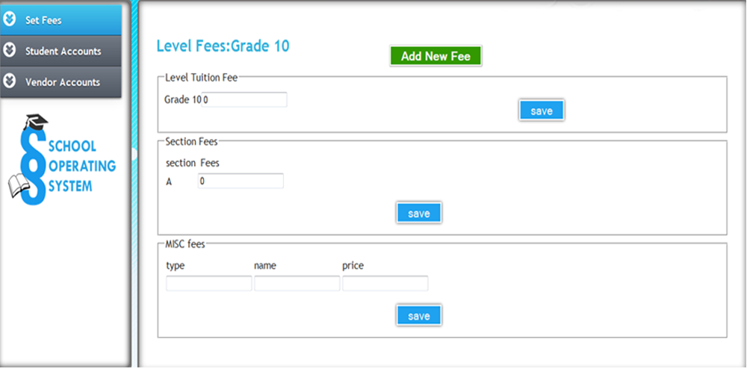
Set Fees
This area allows creating new fee

Slide 4
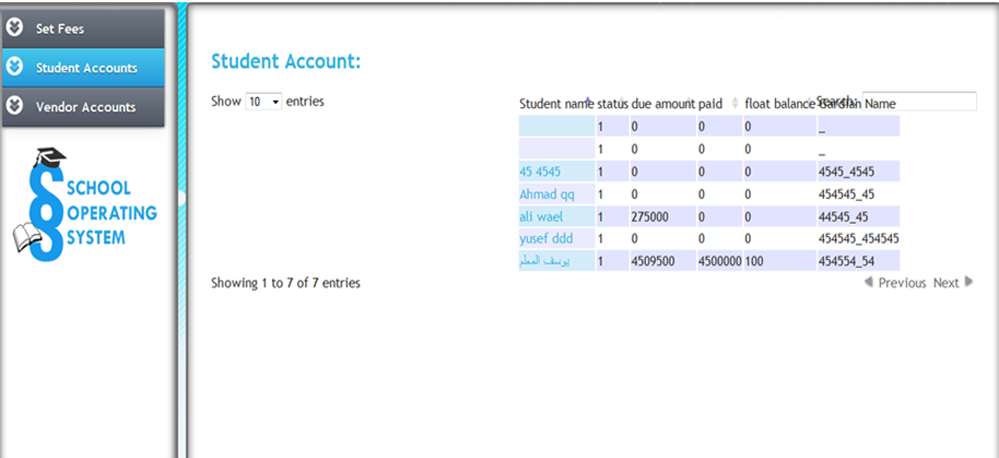
Students Accounts
This area allows creating students accounts

Slide 5
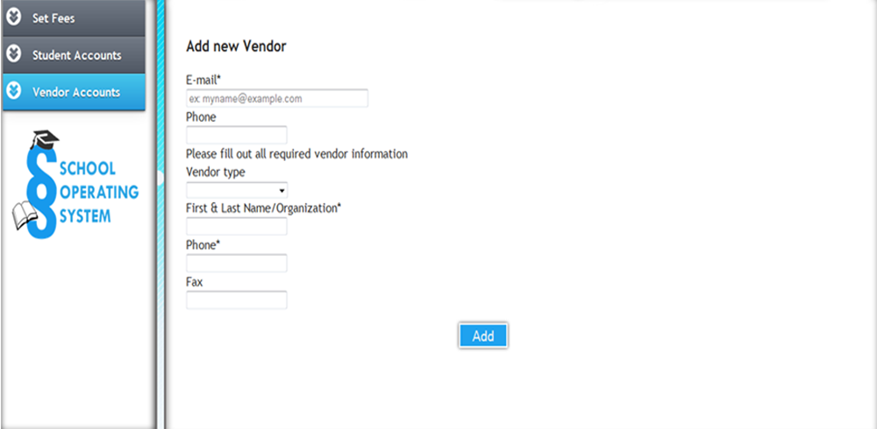
Vendor Accounts
This area creates vendor accounts

Slide 6
SOS
Manager Domain
Plan Academic Year
Teacher & Staff Recruiting
Student Registration
Teacher & Department Performance Management

Slide 7
Students

Slide 8
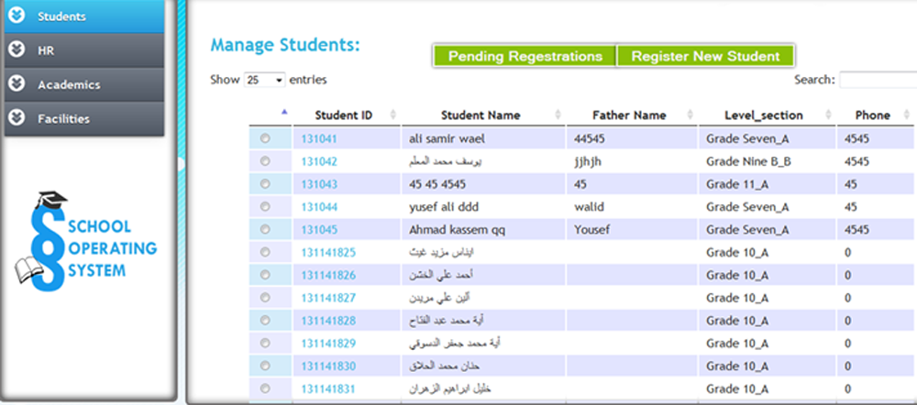
Student
This area allows searching and registering new students.

Slide 9
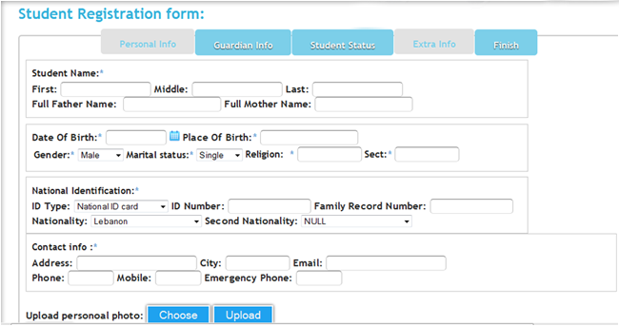
Student
This area allows searching and registering new students.

Slide 10
Academics

Slide 11
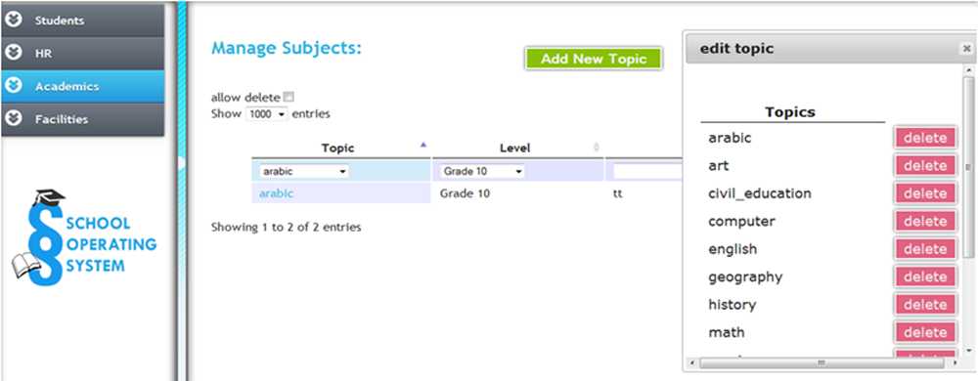
Academics
Manage Subjects area allow creating and deleting subjects.

Slide 12
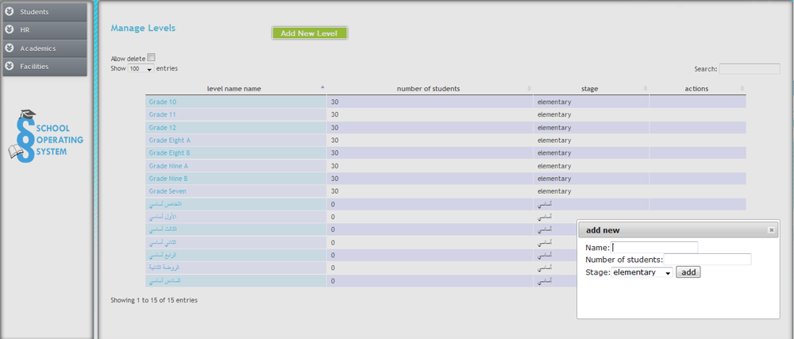
Academics
Manage levels is to add new levels

Slide 13
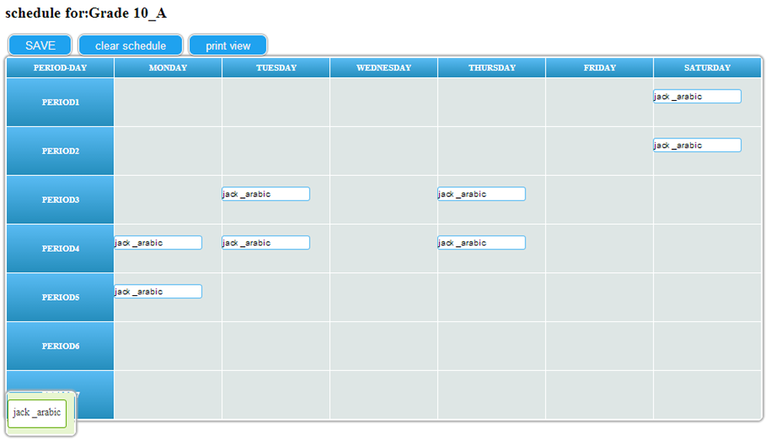
Scheduling
This area is to categorize subjects,grades,teachers and days.

Slide 14
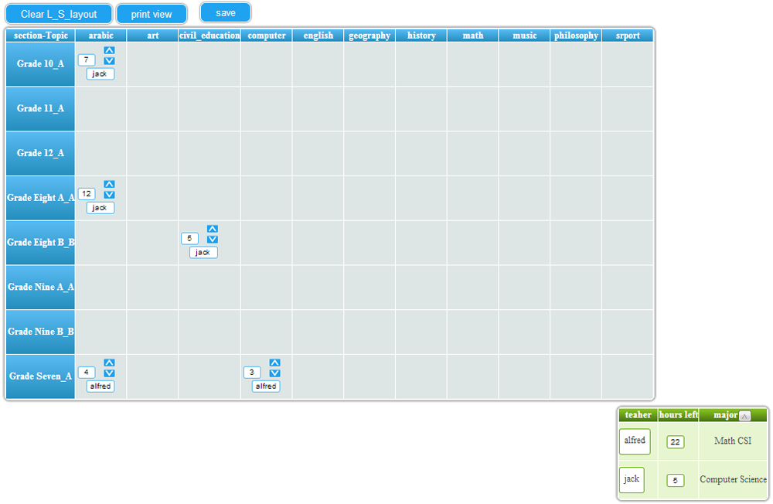
Scheduling

Slide 15
Human Resource

Slide 16
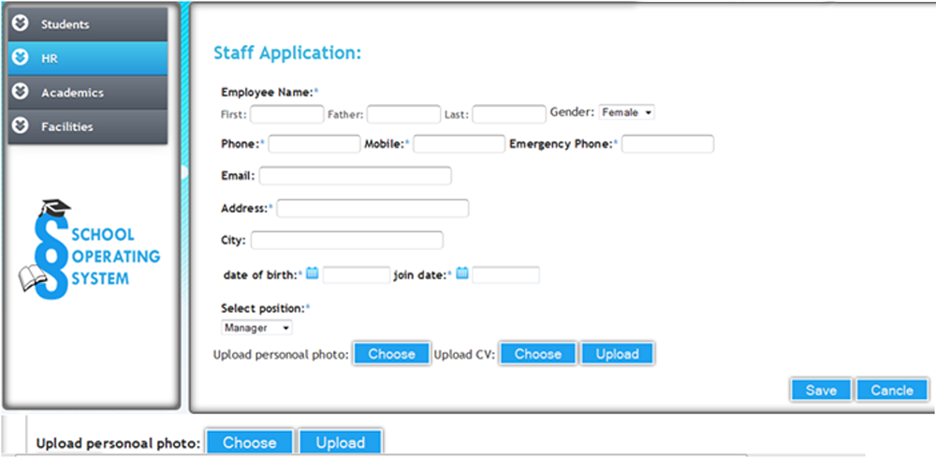
HR
Staff
Teachers

Slide 17
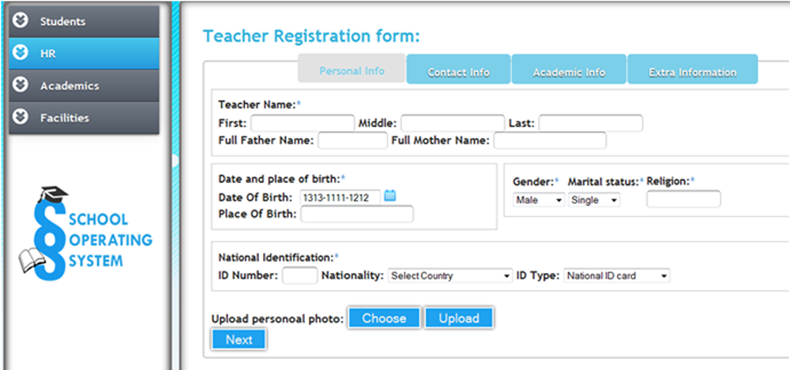
HR
HR button contains two elements: Staff and Teachers in which the first is to create new staff and second is to add new teachers

Slide 18
Facilities

Slide 19
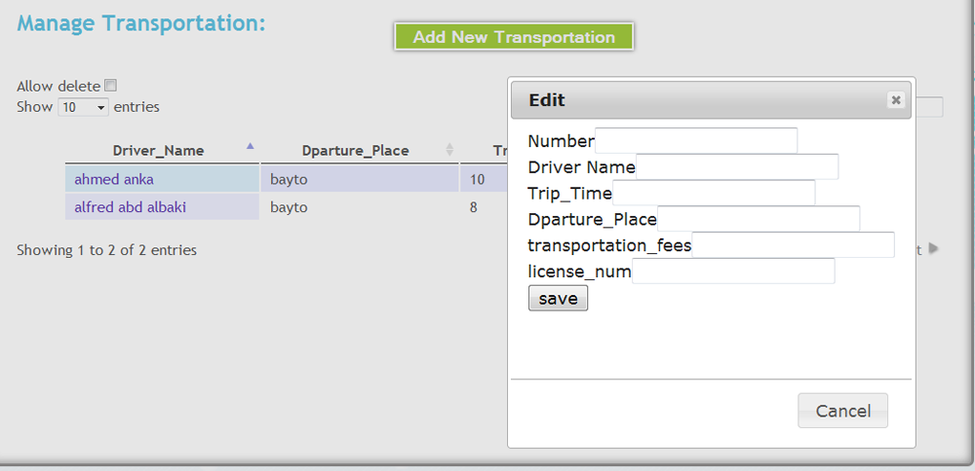
Facilities
Two sub areas
-Transportation
-classrooms

Slide 20
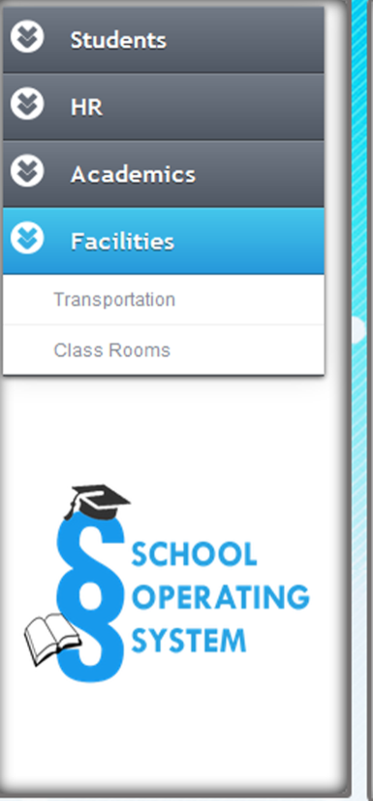
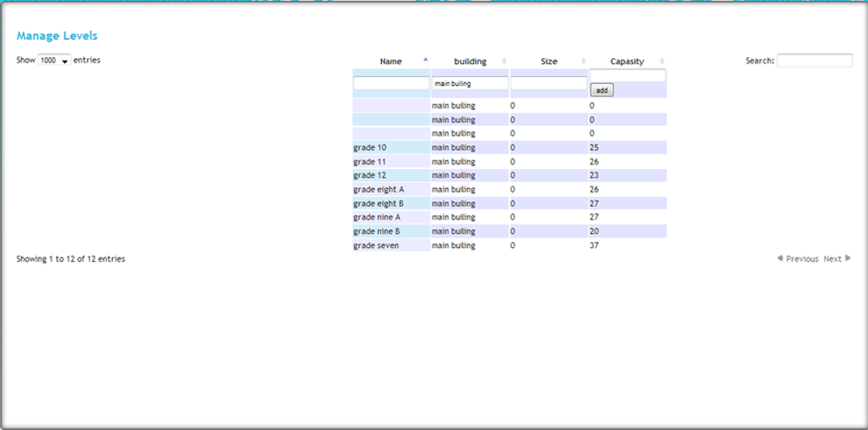
Facilities
-classrooms

Slide 21
SOS
Teacher Domain
Plan Annual Syllabus
Plan Daily Activities
Detailed Tracking of 24 Dimensions of Student Performance
Unlimited Notes on (Department - Class - Student ) Level

Slide 22
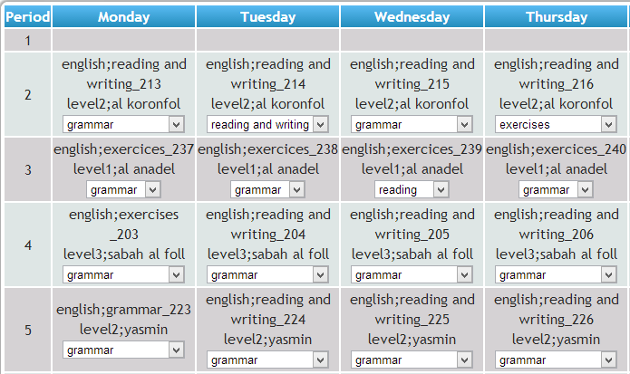
SOS
Teacher Domain
Plan Annual Syllabus

Slide 23
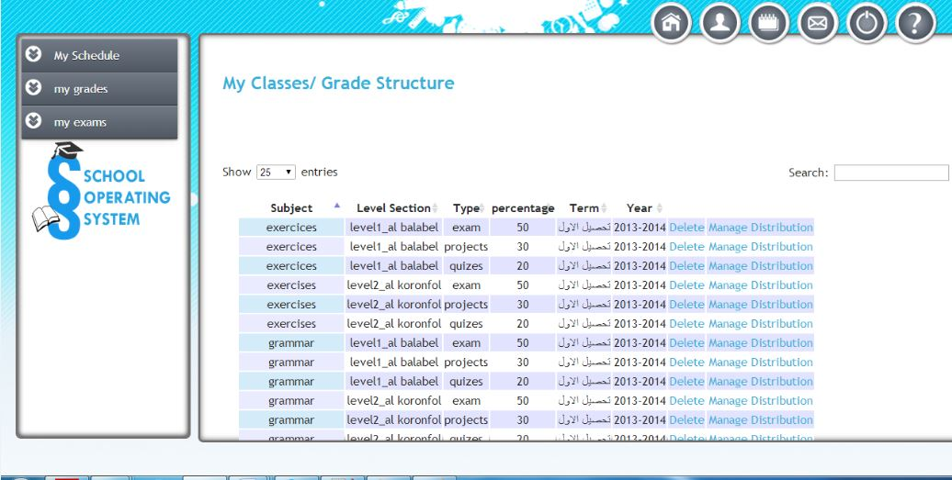
SOS
Teacher Domain
Manage exams

Slide 24
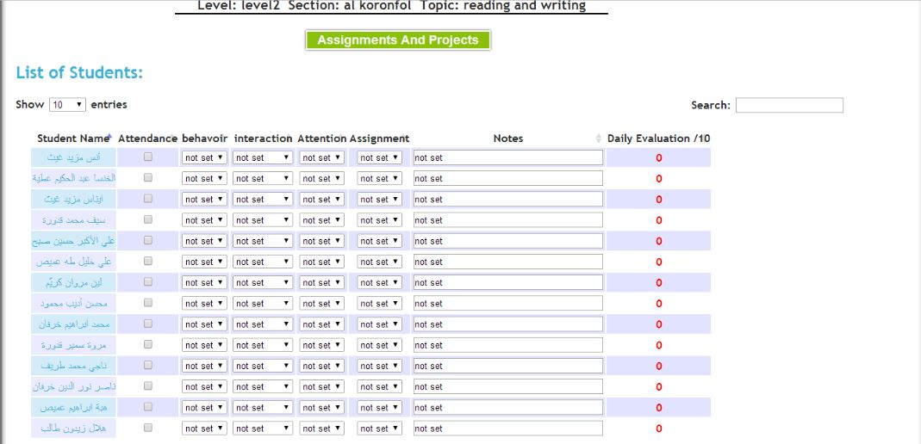
SOS
Teacher Domain
Daily evaluation

Slide 25
SOS
Parent Domain
Manage Your Student’s (Daily - Weekly – Monthly) Activities
Track Your Students (Academic – Social – Behavioral ) Progress
Review Financial Relationship With School
Make Payments Online

Slide 26
SOS
Student Domain
Manage Your Student’s (Daily - Weekly – Monthly) Activities
Track Your Students (Academic – Social – Behavioral ) Progress
Review Financial Relationship With School
Make Payments Online

Slide 27
SOS
Sys Admin Domain
Create & Manage Users & Groups and Assign Right & Privileges
Maintain System Security & Routine Tasks

Slide 28
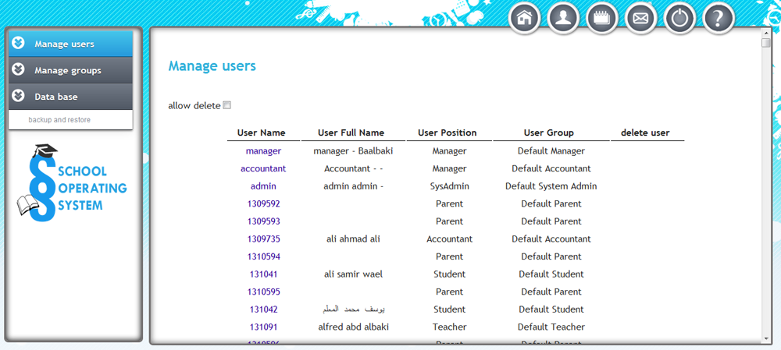
Manage users
This area allows the Admin to add, edit and delete users.

Slide 29
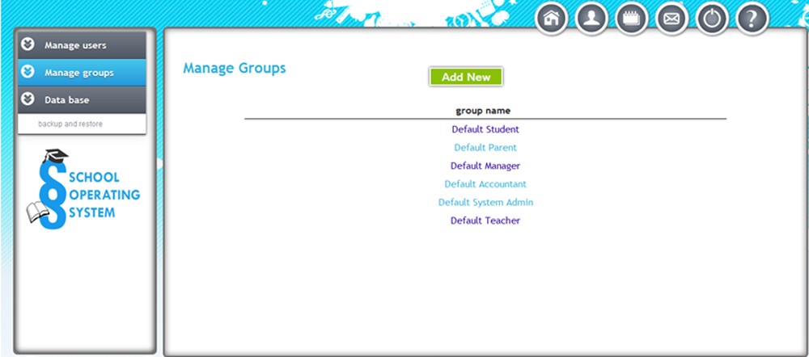
Manage groups
This area allows the admin to add ,edit and delete groups.

Slide 30
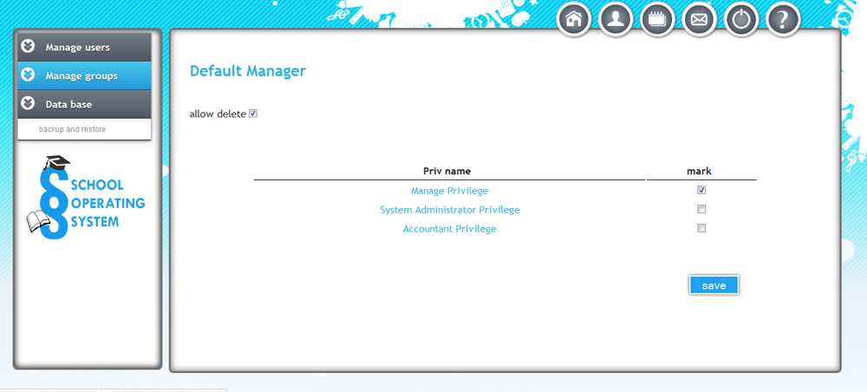
Manage groups

Slide 31
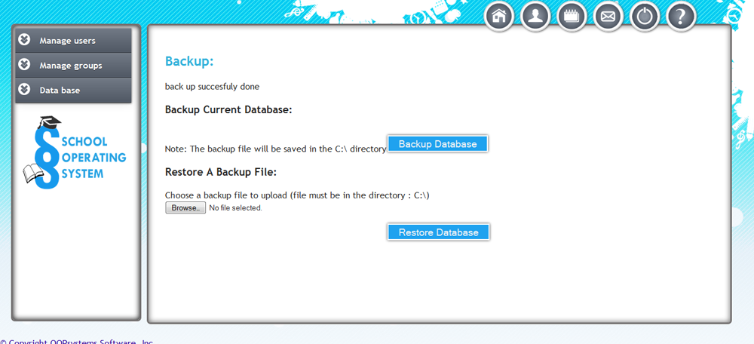
Database
Database button allows the admin to backup database and restore it
when he wants.

